Slide 1
Room Booking Business Analysis
Business Overview-
One room booking organization like(Oyo, Bookmyhotel) want to business dashboards with multiple key indexes, graphs etc.
This dashboards are helpful to management team how business patterns are varying in past so they can predict upcoming business opportunity.
They want some key insights to improve revenue generated and also what was the factors affecting on revenue so business team make plan accordingly to improve it.
Requirement gathering- Prepare document for whatever requirement, key indexes needed to show in dashboard with the help of business team.
Analytics Steps-
Data Extraction - .CSV files from business team.
Data Cleaning - With the help of Power Query Editor .
Data Modeling - Making connection with fact and dimension table in Power Bi.
Data Visualization - To create interactive Power Bi Dashboards.
Knowledge Transfer - Whatever insights by analyzing the dashboard in front of business team.

Slide 2
Requirement Gathering
By connecting business team we got requirements regarding whatever key parameter required in dashboard –
Sr. No. | Measures | Description / Purpose
1 | Revenue | To get the total revenue realized
2 | Total Bookings | To get the total number of bookings happened
3 | Total Capacity | To get the total capacity of rooms present in hotels
4 | Total Succesful Bookings | To get the total succesful bookings happened for all hotels
5 | Occupancy % | Occupancy means total successful bookings happened to the total rooms available(capacity)
6 | Average Rating | Get the average ratings given by the customers
7 | No of days | To get the total number of days present in the data. In our case, we have data from May to July. So 92 days.
8 | Total cancelled bookings | To get the"Cancelled" bookings out of all Total bookings happened
9 | Cancellation % | calculating the cancellaton percentage.
10 | Total Checked Out | To get the successful 'Checked out' bookings out of all Total bookings happened
11 | Total no show bookings | To get the "No Show" bookings out of all Total bookings happened ("No show" means those customers who neither cancelled nor attend to their booked rooms)

Slide 3
11 | Total no show bookings | To get the"No Show" bookings out of all Total bookings happened ("No show" means those customers who neither cancelled nor attend to their booked rooms)
12 | No Show rate % | calculating the no show percentage.
13 | Booking % by Platform | To show the percentage contribution of each booking platform for bookings in hotels. We have booking platforms like makeyourtrip, logtrip, tripster etc)
14 | Booking % by Room class | To show the percentage contribution of each room classover total rooms booked. We have room classes like Standard, Elite, Premium, Presidential.
15 | ADR | Calculate the ADR(Average Daily rate) It is the ratio of revenue to the total rooms booked/sold. It is the measure of the average paid for rooms sold in a given time period
16 | Realisation % | calculate the realisation percentage. It is nothing but the successful "checked out" percentage over all bookings happened.
17 | RevPAR | Calculate the RevPAR(Revenue Per Available Room) RevPAR represents the revenue generated per available room, whether or not they are occupied. RevPAR helps hotels measure their revenue generating performance to accurately price rooms. RevPAR can help hotels measure themselves against other properties or brands.
18 | DBRN | calculate DBRN(Daily Booked Room Nights) This metrics tells on average how many rooms are booked for a day considering a time period
19 | DSRN | calculate DSRN(Daily Sellable Room Nights) This metrics tells on average how many rooms are ready to sell for a day considering a time period
20 | DURN | calculate DURN(Daily Utilized Room Nights) This metric tells on average how many rooms are succesfully utilized by customers for a day considering a time period

Slide 4
21 | Revenue WoW change % | To get the revenue change percentage week over week.
22 | Occupancy WoW change % | To get the occupancy change percentage week over week.
23 | ADR WoW change % | To get the ADR(Average Daily rate) change percentage week over week.
24 | Revpar WoW change % | To get the RevPar(Revenue Per Available Room) change percentage week over week.
25 | Realisation WoW change % | To get the Realisation change percentage week over week.
26 | DSRN WoW change % | To get the DSRN(Daily Sellable Room Nights) change percentage week over week.
Around 26 measures we need to create for better analyzing the business health. In that 6 are Key Performance Indexes KPI-
RevePar - Revenue Per Available Rooms Occupancy% -Occupancy means total successful bookings happened to the total rooms available(capacity) Realisation -It is nothing but the successful "checked out" percentage over all bookings happened. DSRN - Daily Sellable Room Night ADR - Average Daily Rate DBRN - Daily Blocked Room Nights DURN - Daily Utilized Room Night

Slide 5
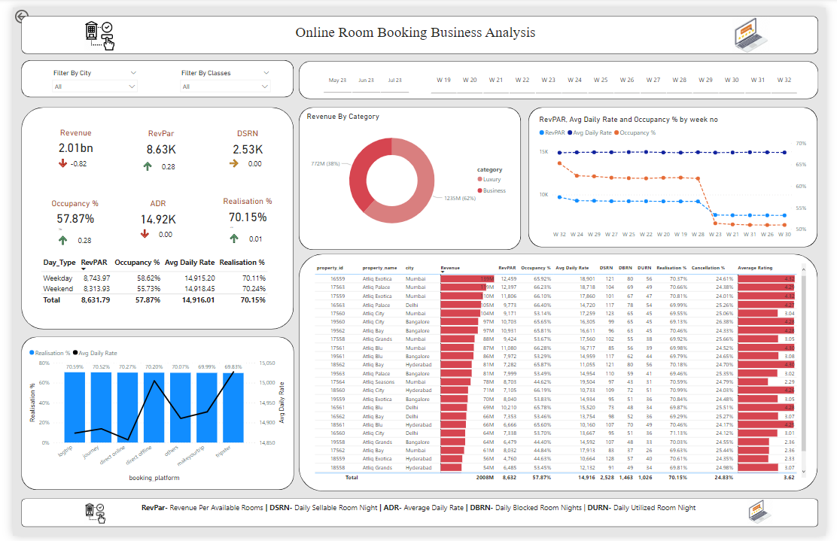
Data Visualization-Final Dasboard

Slide 6
Insights-
Average rating of hotels n different platforms like google map, online booking website etc. are plays important role in revenue generation. More average rating means more revenue because they provide good quality service.
By seeing trend by matrix graph we say whatever room price at week day we can increase at weekend so hotel owner need to adopt dynamic pricing rate policy so they should improve the revenue. In May Jun July it was very helpful.
By seeing weekday and weekend revenue table graph it clearly indicates hotel owner not only following dynamic pricing but also weekend pricing also. It as big opportunity to improve revenue by adapting weekend and dynamic pricing.
There are huge amounts of online booking channel but by seeing Realisation % by ADR graph we can say the booking by your own hotel channel was high ADR. Also booking channel depend upon offers like discount coupon, referral etc.
If average rating is high then occupancy%[Occupancy means total successful bookings happened to the total rooms available(capacity)],Realisation %[It is nothing but the successful "checked out" percentage over all bookings happened.] also increase.
For revenue four pricing policies – Weekday/Weekend Pricing Flat Pricing Dynamic Pricing

